Slide 1
Machine Learning Project
Samuel Odulaja

Slide 2
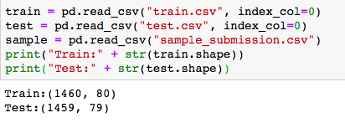
Background
Kaggle Dataset
Contains around 1400 house prices and associated predictors
79 explanatory variables describing aspects of residential homes in Ames, Iowa
Using advanced regression techniques, predict the final price of each home

Slide 3
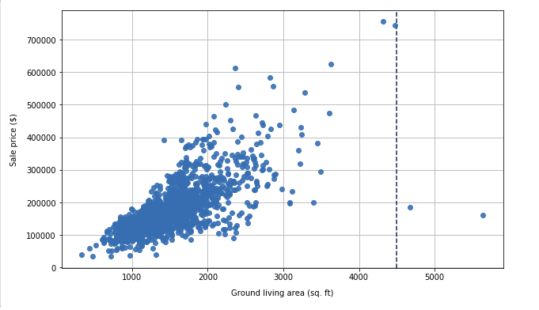
Concatenate training and testing features
Concatenated features so that we don’t have to impute missing values, transform features, etc.
Did this for both training and test sets
Removed houses with ground living area greater than 4,500 sq.ft from the training sets

Slide 4
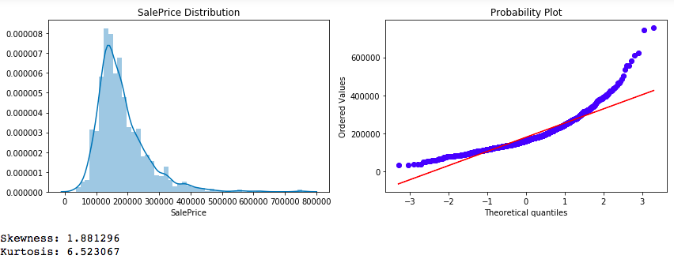
SalePrice Distribution

Slide 5
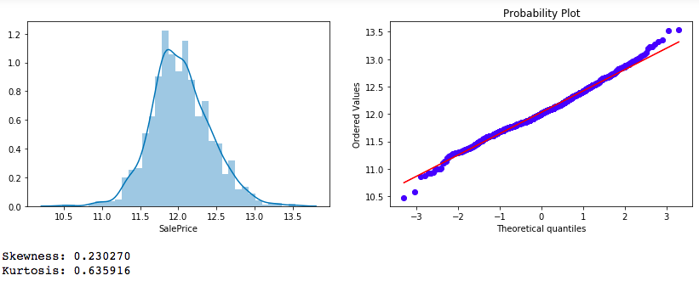
SalePrice Transformation
Transformed target variable
y_train = np.log(train["SalePrice"])

Slide 6
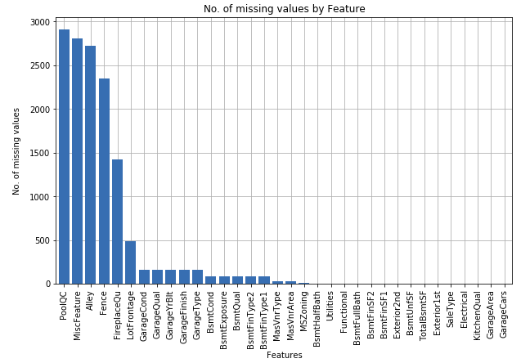
Impute missing values
The plot shows the number of missing values in columns with at least one missing value

Slide 7
Engineer features
Creating new features for dataset
TotalSF, TotalPorchSF, TotalBath

Slide 8
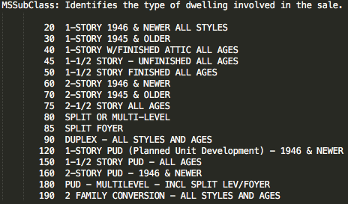
Categorize MSSubClass and YrSold
From the MSSubClass description, the levels don’t seem to have a natural ordering
Represented the MSSubClass as a categorical feature rather than a numerical one
Also represented YrSold as a categorical feature
Allowed for a more flexible relationship with SalePrice

Slide 9


Transform features
To better highlight any recurring patterns in SalePrice, MoSold was transformed
Also transformed highly skewed features using code below
Used pd.get_dummies to convert all categorical values into dummy variables

Slide 10
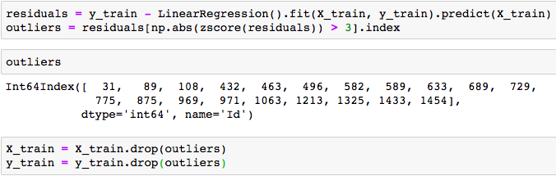
Removing outliers from training data
Fitted a linear model to the training data and removed examples with a studentized residual greater than 3
Notes:
a studentized residual is the quotient resulting from the division of a residual by an estimate of its standard deviation

Slide 11
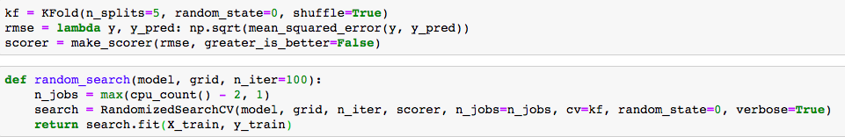
Define random search
Used random search to optimize hyperparameters for each of our models
Used a 5-fold cross validation to score each iteration

Slide 12
Trained Models
Overall the models did well with Gradient Boosting performing the best.
Ridge: 0.0778
Lasso: 0.0796
SVR: 0.0712
LGBM: 0.0640
GBM: 0.0436

Slide 13
Creating Predictions and RSME
Stored the predictions of the based learners and stacked ensemble in a list
Averaged the predictions and gave a weight of 0.13 to the based learners and .35 to the stacked ensemble
RSME: 0.3848232

Slide 14
Conclusions
Overall the models seemed to perform well
However the RSME seemed a little high
Most likely an error in the code
In the future would improve on RSME, by using different methods.

